Slide 1
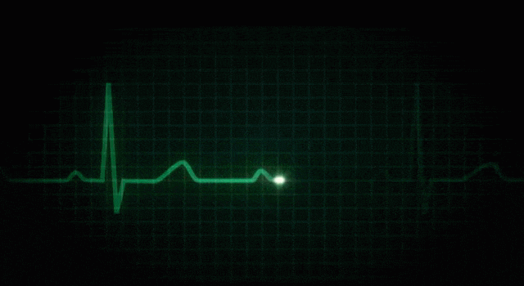
IR PULSE DETECTOR AND HEART RATE MONITOR
Advanced Biomedical Instrumentation
BSC(H) INSTRUMENTATION
SUBMITTED BY:-
DHARMESH BHARDWAJ
RITESH DHIMAN
LAKSHAY BHATIA
PERDEEP KUMAR
ROHIT KUMAR

Slide 2
INTORDUCTION
In this project we demonstrate the idea of heart beat monitoring and patient heart analyser system. we check the patient parameter such as heart beat. In this project we measure the heart beat that sense and measure the heart beat and display in LCD and plot the wave on serial plotter.
Heart beat measure mode
We measure the heartbeat and display in LCD and this condition plot the graph wave on serial plotter

Slide 3

WHY MONITORING…..?
Around 2 million people are at high risk of having heart attack.
It would be helpful if there was a way for these people to monitor their heart.
So we have a problem. This is the way our project focuses on how we can utilize this problem and find the solution.

Slide 4

CARDIAC ARRHYTHMIAS
An abnormality of the cardiac rhythm is called cardiac arrhythmia.
Arrhythmia may cause sudden death, syncope, heart failure, dizziness, palpitations or no symptoms at all.
There are two main type of arrhythmia:
1. Bradycardia:-the heart rate is SLOW (<60 b.p.m)
2. Tachycardia:- the heart rate is FAST (>89 b.p.m)

Slide 5
AVERAGE HEART RATE

Slide 6
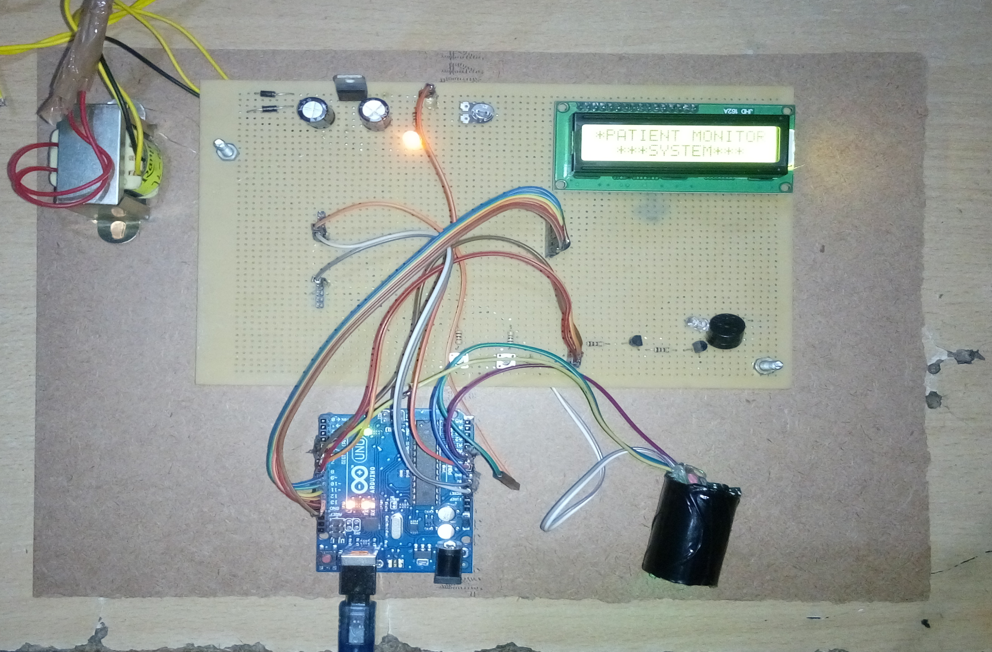
Top view of our project

Slide 7
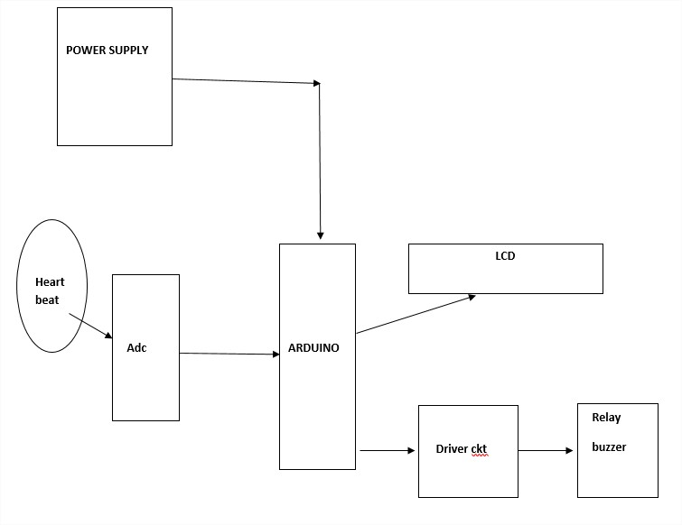
Block Diagram

Slide 8
CIRCUIT DIAGRAM

Slide 9
COMPONENTS
Transformer
ARDUINO UNO
Diode
Resistor
Capacitor
LED
Regulator
Battery
Switch
Transistor

Slide 10
SOFTWARE USED
Topwin for IC programming
ARDUINO IDE
Proteus software for ckt design
Coding lan for assembly language

Slide 11
TESTING TOOLS
CRO
Led indication
Multi-meter

Slide 12
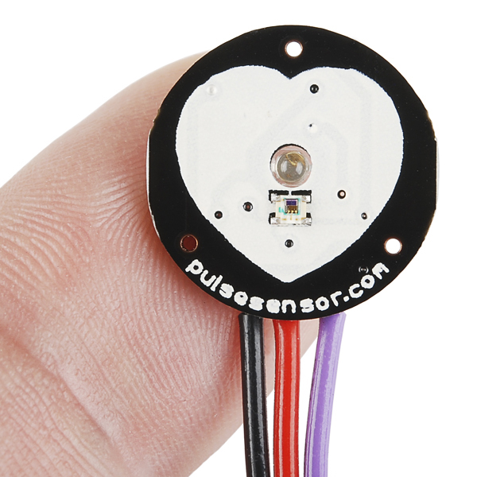
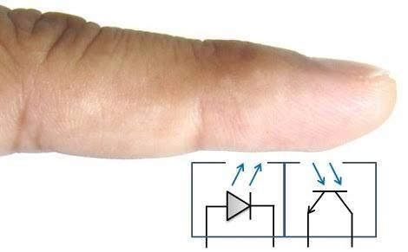
Heart Rate Sensor
How sensor work…..?
The sensor itself consists of an infrared emitter and detector mounted side-by-side and pressed closely against the skin.
When the heart pumps, blood pressure rises sharply, and so does the amount of infrared light from the emitter that gets reflected back to the detector.
Continued..

Slide 13
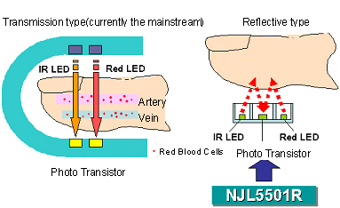
The detector passes more current when it receives more light, which in turn causes a voltage drop to enter the amplifier circuitry.
This design uses two consecutive operational amplifiers to establish a steady baseline for the signal, emphasize the peaks, and filter out noise.
Both op-amp are contained in a single integrated circuit(IC or “chip”)

Slide 14
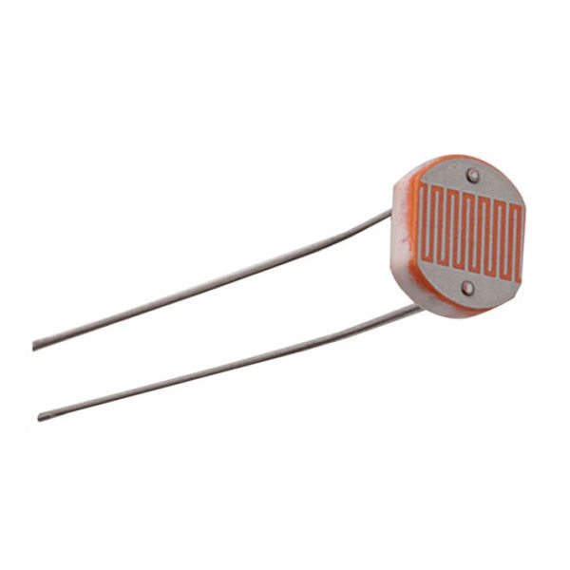
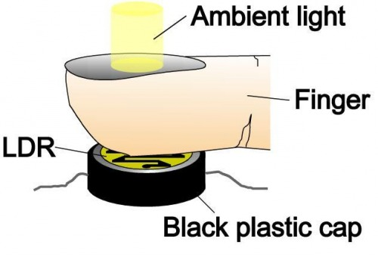
LDR Sensor
How sensor work…?
Light Dependent Resistor (LDR):- An LDR is a component that has a (variable) resistance that changes with the light intensity that falls upon it. This allows them to be used in light sensing circuits.
A LDR works on the on the principle of photoconductivity.
Photo conductivity is an optical phenomenon in which the materials conductivity reduces when light is absorbed by the material.
Continued..

Slide 15
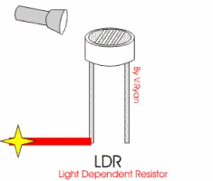
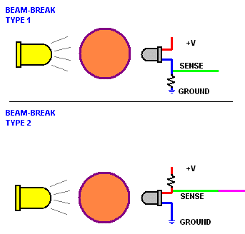
When light falls i.e. when the photons falls on the device, the electrons in the valance band of the semiconductor material are excited to the conduction band.
When light having enough energy is incident on the device, more and more electrons are excited to the conduction band which result in large number of charge carriers.
The result of this process is more and more current starts following and it is said that the resistance of the devices has decreased.

Slide 16

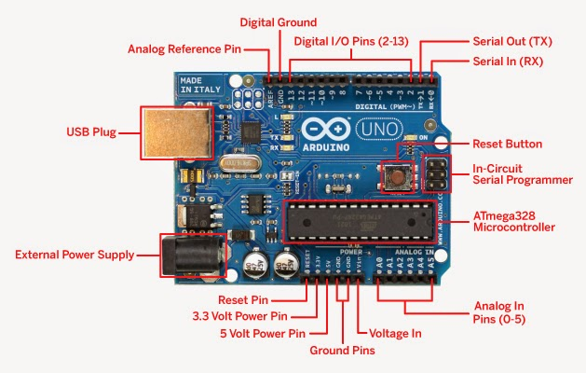
Arduino
The Arduino Uno can be powered via the USB connection or with an external power supply. The power source is selected automatically. The Arduino Uno is a microcontroller board based on the ATmega328.
Continued..

Slide 17
External (non-USB) power can come either from an AC-to-DC adapter (wall-wart) or battery. The adapter can be connected by plugging a 2.1mm center-positive plug into the board's power jack. Leads from a battery can be inserted in the Gnd and Vin pin headers of the POWER connector.
Features:
Microcontroller | ATmega328
Operating Voltage | 5V
Input Voltage | 7-12V
Digital I/O Pins | 14 (of which 6 provide PWM output)
Analog Input Pins | 6
SRAM | 2 KB (ATmega328)
EEPROM | 1 KB (ATmega328)
DC Current per I/O Pin | 40 mA
Continued..

Slide 18
Pin diagram of Atmega328
Continued..

Slide 19
Goals And Objectives
User-Friendly
Low-Cost
Modular
Power-Efficient
The system is:
Modular
User-Friendly
Low-Cost
Power-Efficient

Slide 20


PROBLEM CONTENT
Components
Availability
How to decide
The value of components
Circuit
Designing
How to give
the effort of
soldering properly
Programming of
sensor
signal sending and
sensor interfacing

Slide 21
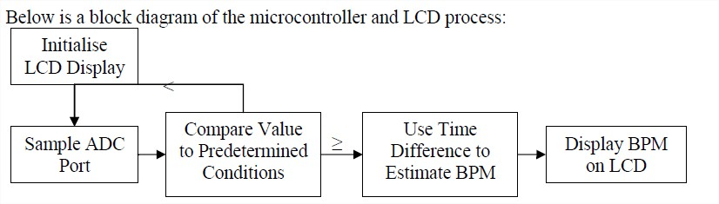
Processing & Display
Due to the use of a microcontroller to calculate the beats per minute (BPM), it was decided that a liquid crystal display (LCD) module would be the most flexible way of displaying this numerical output. It was originally planned that several seven segment displays could be used, but again it was deemed worthwhile to integrate the display unit together and limit the number of components required. In addition, the information which the LCD could convey was greater.

Slide 22
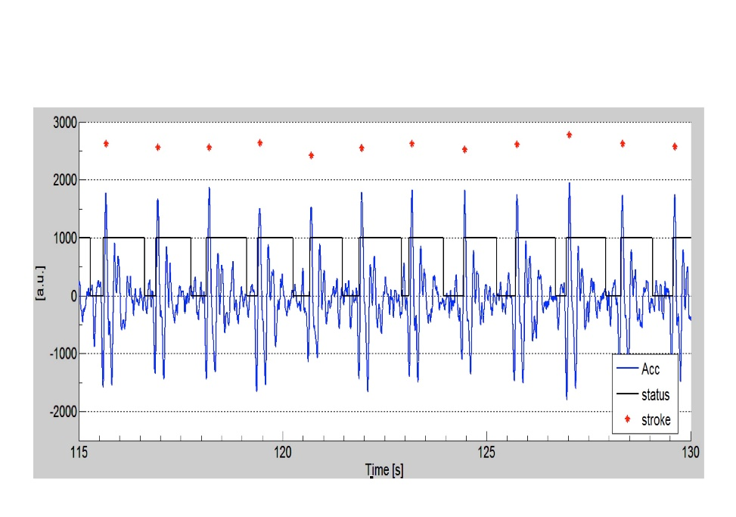

Noise in pulse
Noise from the environment will easily swamp the tiny pulse signal from the heart. The leads connecting the electrode to the amplifier will act like an antenna which will inadvertently receive unwanted radiated signals. Such signals are for example the 50Hz from power lines and emf’s from fluorescent lights will add a tiny sinusoidal wave which is generally quite difficult to filter away.
Muscles other than the heart also produce voltage potentials and these can also be detected although the large relative size and regularity of the heart muscles help to differentiate it from the rest.
Without any noise
With noise

Slide 23
Enhancements
A high gain amplifier with a high Common Mode Rejection Ratio (CMRR) will be used to receive the desired signal. Also having a frequency response of at least 50Hz to detect the heart pulse.
A low pass filter will be implemented to remove the noise. Because most of the noise types discussed are of high frequency while the desired signal is relatively low a single pole filter will suffice.
The final circuit will be implemented in a Printed Circuit Board (PCB) to reduce the number of “radiating and transmitting” sources on the device (loose wires and exposed long component legs).
Necessarily long wires for the contacts will be shielded

Slide 24
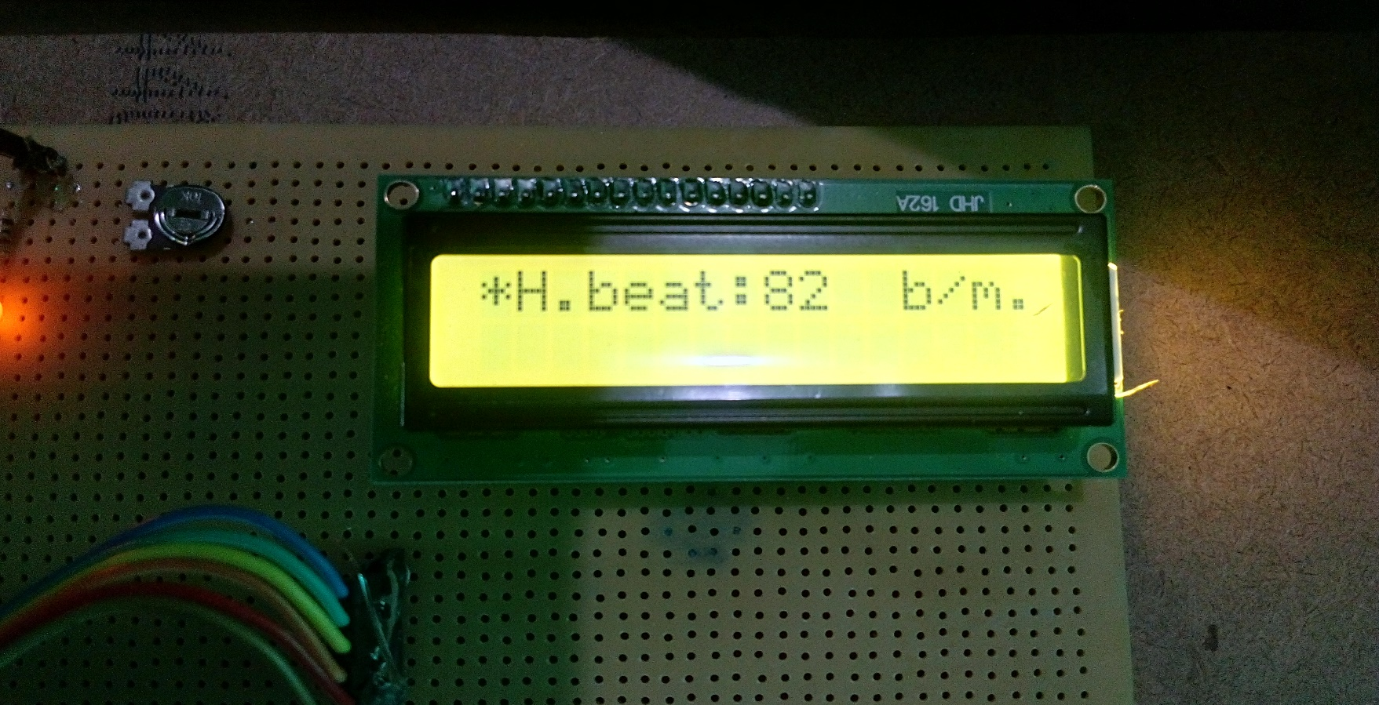
RESULTS
Heart beat per min. is displayed on LCD
Continued..

Slide 25
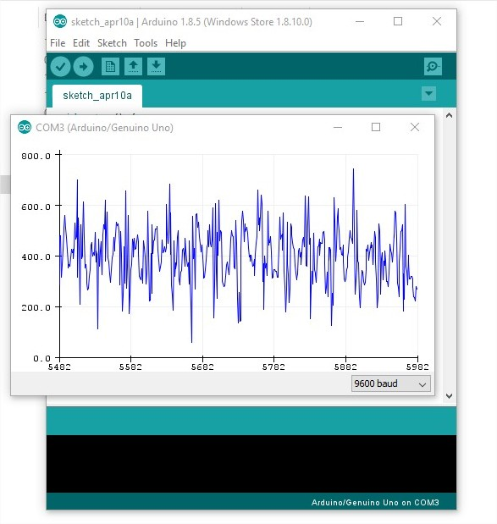
RESULTS
The waveform collected from a ‘patient’. It capture from the Arduino ide serial plotter for 82 BPM. The gain was adjusted via the two potentiometers to obtain a suitable trace.

